Slide 1
EDA on Amazon Top 50 Bestsellers from 2009 to 2019

Slide 2
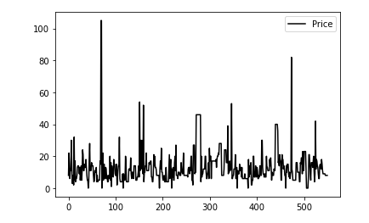
Analysis of Book Prices
Minimum Price is 0 dollars, Maximum Price is 105 dollars, And Average Price is 13.1 dollars

Slide 3
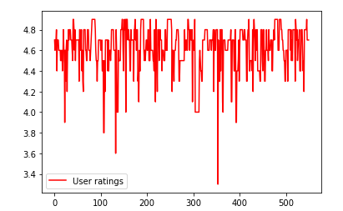
Analysis of Book User Ratings
Minimum Rating is 3.3, Maximum Rating is 4.9, And Average Rating is 4.618363636363645

Slide 4
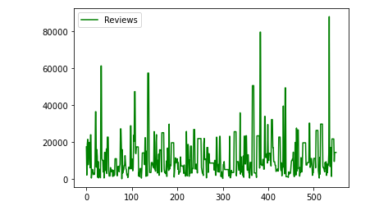
Analysis of Reviews given by Users
Lowest Reviews on a book is 37, Highest Reviews on a book is 87841, And Average of Reviews is 11953.281818181818

Slide 5
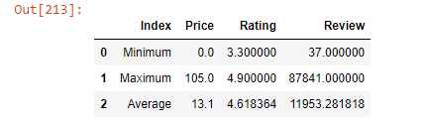
Summary of the Analysis of the Price, Ratings and Reviews

Slide 6
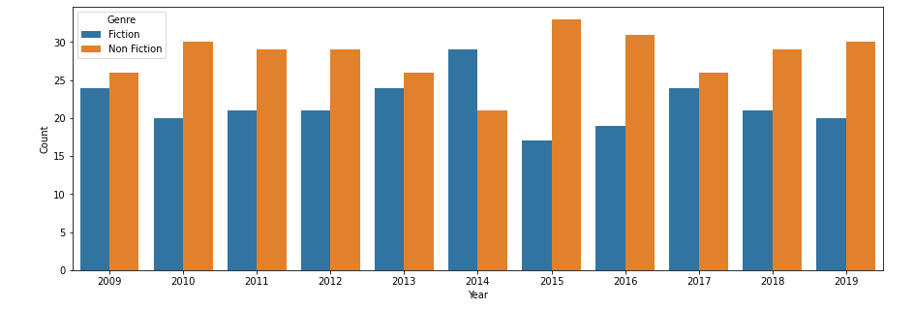
Which Genre Appeared More?
Overall, More Non fictions[310] made it into top than fictions[240].
2014 is the only year where more fictions made it to the list.

Slide 7
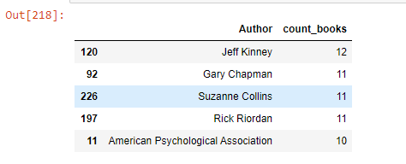
Analysis on Authors who have more books in top list
Even though there are 5 Authors here, we cant determine their positions only by number of books.
So i calculated the Average Ratings of Each of these Authors.

Slide 8
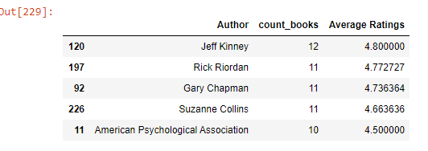
After getting their Average, their positions are more clear.
Here is the final list of Top 5 Authors:

Slide 9
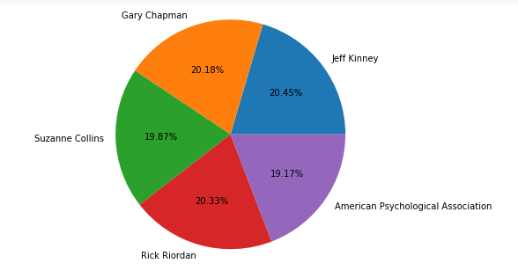
A Final Pie Chart to make is more clear, visually:

Slide 10
Name: Easha Fernandes
Batch: INSAID [GCD August 2020]
Thank You

